Slide 1
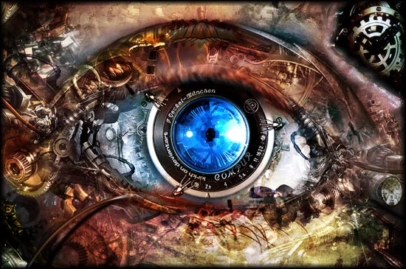
Computer Vision
Alireza Norouzi

Slide 2
What is it?
Make Computers(or Things) Able To See
So Natural For Human, We usually Don’t Think about it
Really Hard!
Why Most of Our Brains Are devoted to it?

Slide 3
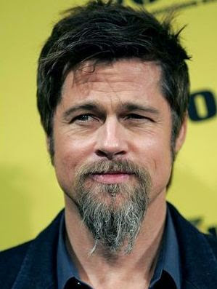

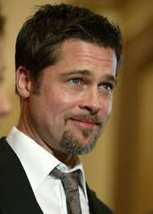

Really Hard!
Just an Example: What makes two people face different?
You think that is easy! Explain it to a computer ☺

Slide 4

How It Begun? A Fun Story
Undergraduate Summer Project (1966 in MIT)

Slide 5

A Fact
We Really Don’t Know Much About our Own Brain 😐
Far Behind a 2 Years Old Baby

Slide 6
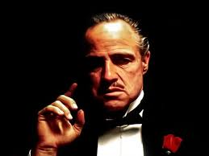
Ok, Ok, What can we Do with It?

Slide 7
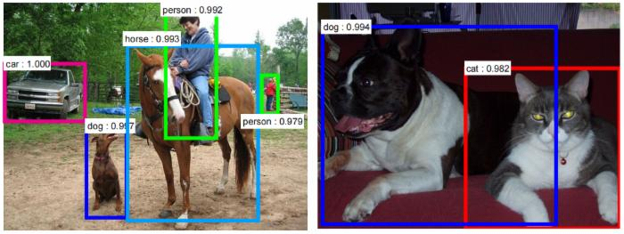
Applications
Object Detection

Slide 8
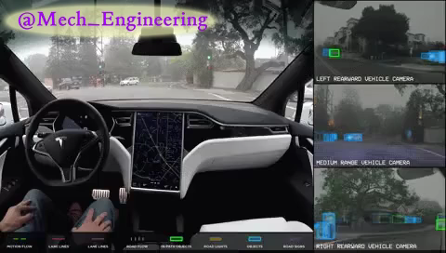
Applications
Object Detection

Slide 9
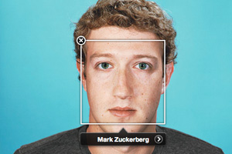
Applications
Face Detection / Recognition

Slide 10
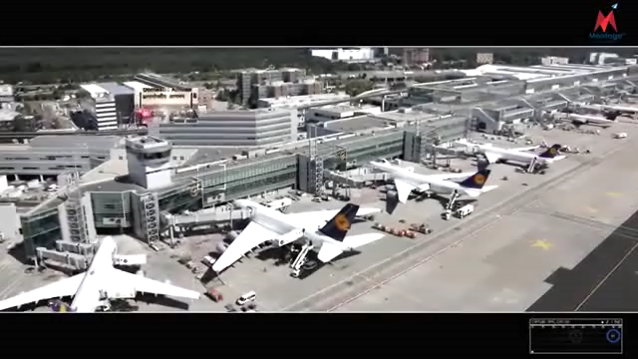
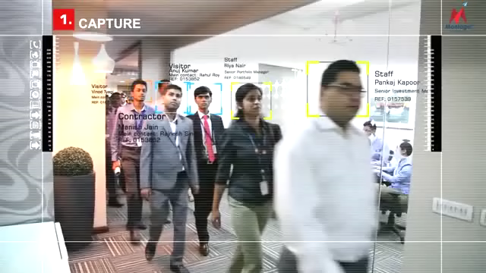
Applications
Face Detection / Recognition

Slide 11
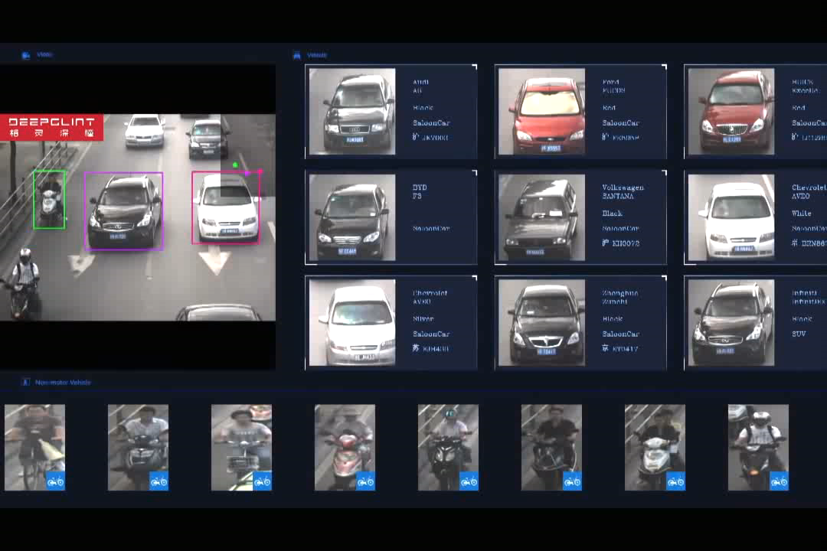
Applications
Intelligent Transportation Systems

Slide 12
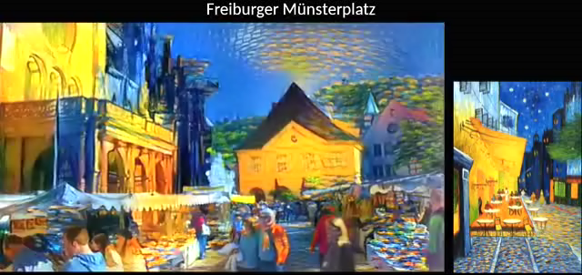
Applications
Art

Slide 13
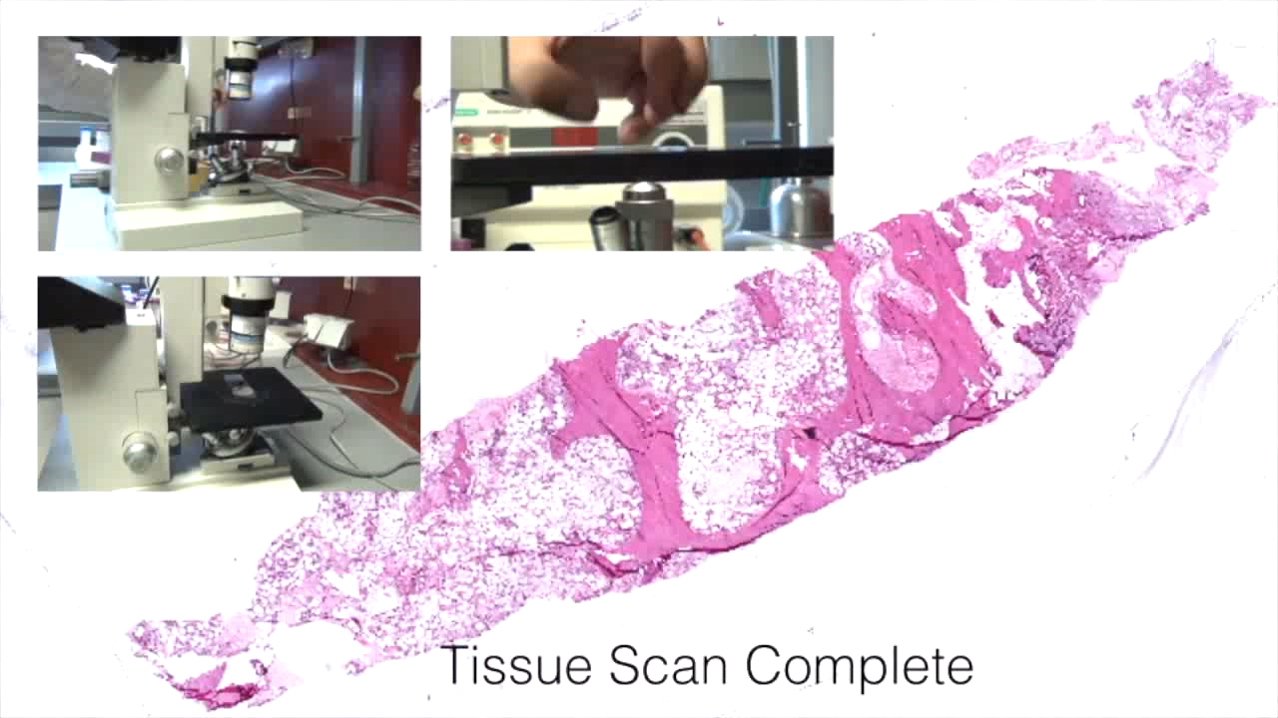
Applications
Medical

Slide 14
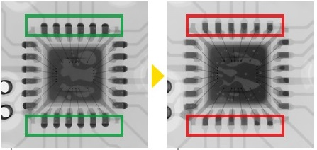
Applications
Industrial Applications

Slide 15

Applications
Industrial Applications

Slide 16
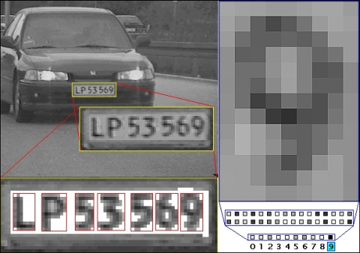
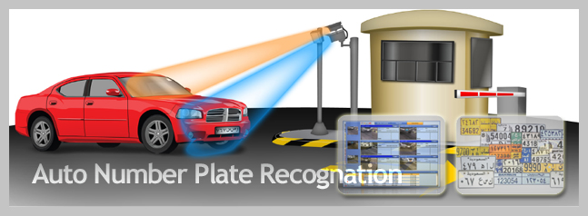

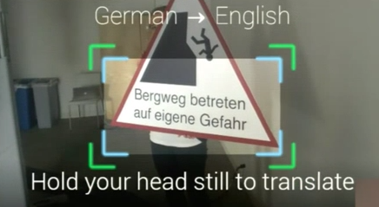
Applications
OCR

Slide 17
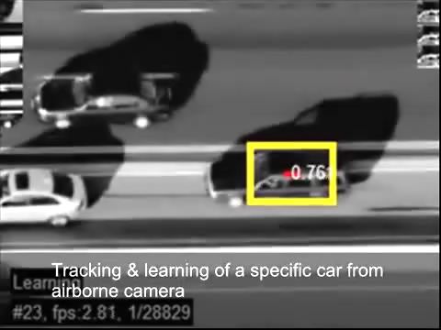
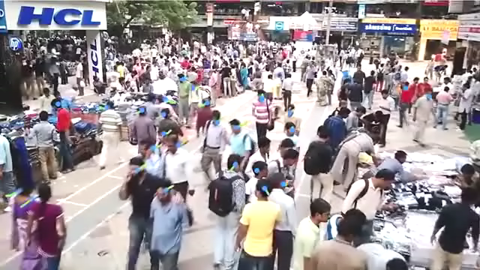
Applications
Tracking

Slide 18
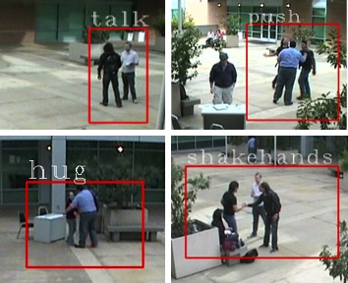
Applications
Activity Recognition

Slide 19
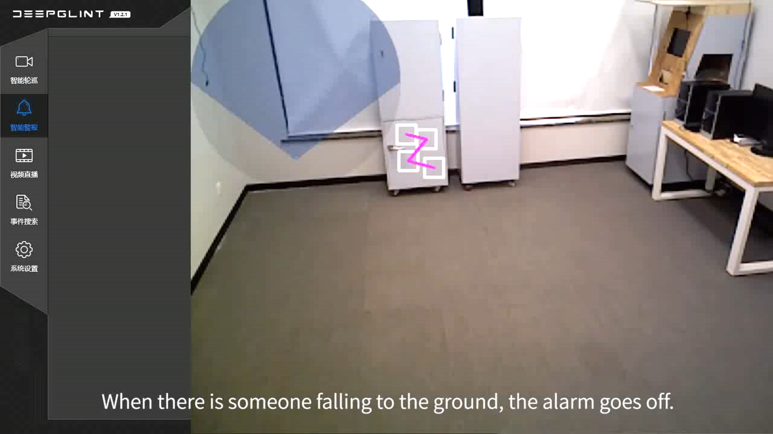
Applications
Activity Recognition

Slide 20
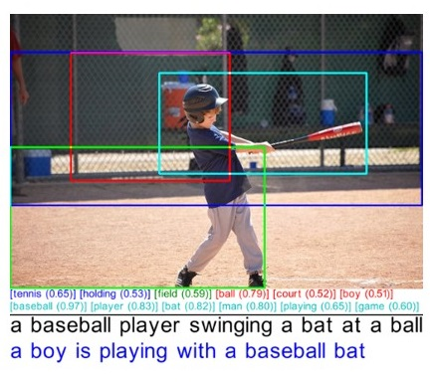
Applications
Image/Video Captioning
Image-Based QA

Slide 21

Applications
Augmented Reality

Slide 22
Applications
… A lot more

Slide 23
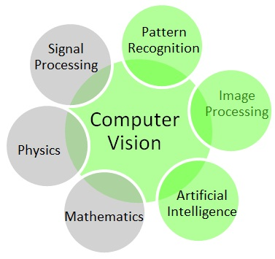
Related Fields

Slide 24

Related Fields
Deep Learning Rules Now !

Slide 25

How To Start?

Slide 26
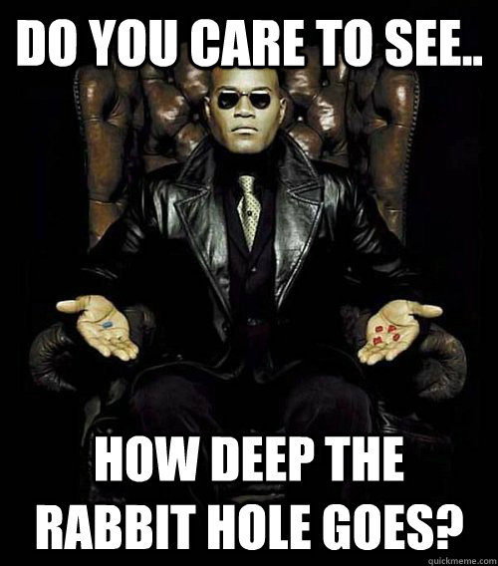

Slide 27


Theories
Active Area of research
A Lot to be Done

Slide 28

No! I take the Blue Pill

Slide 29
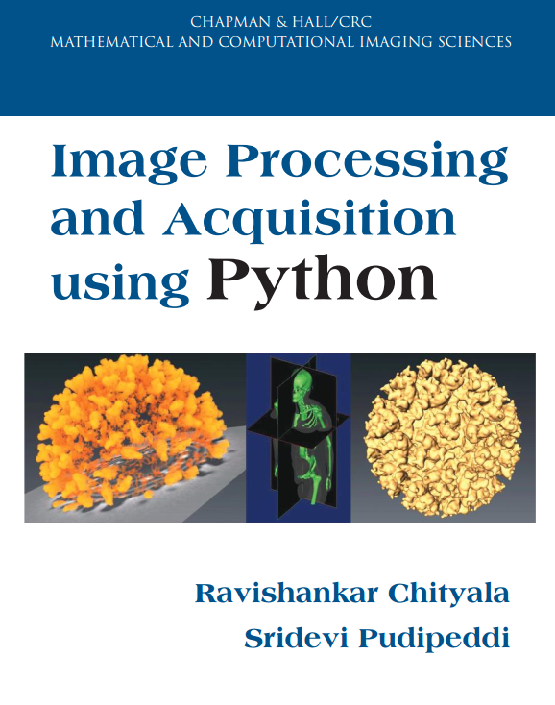


Practical Approach

Slide 30


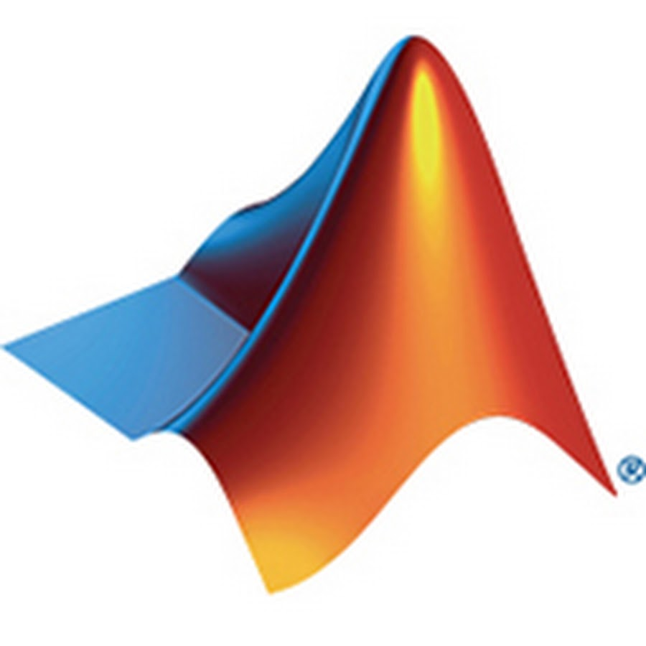

Software Packages
OpenCV
Accord.Net
Matlab
Labview
…
It’s Easy to use Computer Vision in Daily Products

Slide 31
Online Resources
Fundamentals of Digital Image and Video Processing (Coursera)
Introduction to Computer Vision(Udacity)
Computer Vision(UCF)

Slide 32
Just Start & You will Learn A Lot

Slide 33
Market

Slide 34
Companies Around The World
A Lot of active companies all over the world
Search For “computer vision industry”
www.cs.ubc.ca/~lowe/vision.html

Slide 35

What About Iran?

Slide 36

Thank you

